Slide 1

COVID-19 Daily Counts of Cases, Hospitalizations, and Deaths by new York city health department

Slide 2
Introduction
Data set used: Covid-19 Daily Counts of Cases, Hospitalizations, and Deaths
This data set was compiled by the New York City Health Department
Data set posted on data.gov website with the following URL: https://data.cityofnewyork.us/api/views/rc75-m7u3/rows.csv?accessType=DOWNLOAD
Purpose of this project is to analyze the Covid-19 pandemic in NYC
To determine the peaks of daily counts of the pandemic in NYC.
To determine which boroughs were affected the most.
To determine how severe the pandemic was.
To determine what time of the year hospitals need to maximize staffing.

Slide 3
The data set
Data set in CSV format.
Data set posted on data.gov website with the following URL: https://data.cityofnewyork.us/api/views/rc75-m7u3/rows.csv?accessType=DOWNLOAD
1501 rows by 55 columns
Each row is a date starting on 2/29/20 and ending 4/8/24
Each column is a daily count statistic
Data analysis was performed on Jupyter Notebook version 6.5.4 using Python version 3.11.7 packaged by Anaconda, Inc.

Slide 4

Question 1 when did covid-19 peak in new York city?

Slide 5
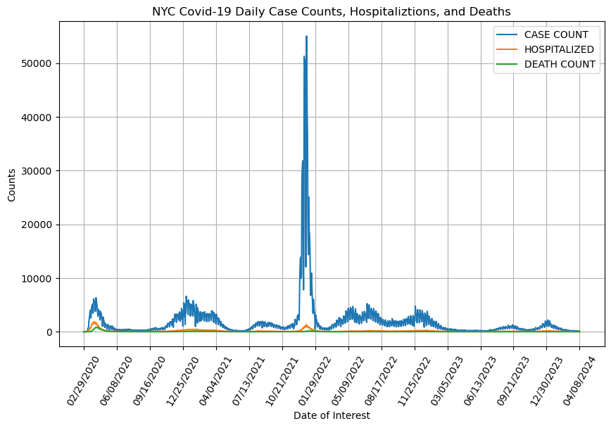
When did Covid-19 peak in New York city?
Line graph used to plot date on the x-axis versus daily counts on the y-axis.
Overlaying confirmed Covid-19 case counts, hospitalizations and deaths caused by Covid-19 on the same graph.
First wave in winter of 2020 has high relative hospitalizations and death.
Second wave in winter of 2020-2021
Third wave in winter of 2021-2022 has very high case counts.
A fourth wave of low sustained case counts for the entire year of 2022 then peters out.

Slide 6

Question 2 which boroughs were affected the most?

Slide 7
Which nyc boroughs were affected the most?
-For this question, the first wave (first 100 days) was chosen to focus in on because of the high percentages of hospitalizations and deaths to confirmed Covid-19 case counts.
-The next 3 graphs are line graphs that display date on the x-axis and daily case counts on the y-axis. Each individual borough’s daily counts are overlayed on the same graph. The daily counts are of confirmed Covid-19 cases, hospitalizations resulting from Covid-19, and deaths resulting from Covid-19.
-The fourth graph shows an ordered bar chart of the summed total counts for each of the boroughs. Queens had the highest count totals for all categories and Staten Island had the least totals for all categories.

Slide 8
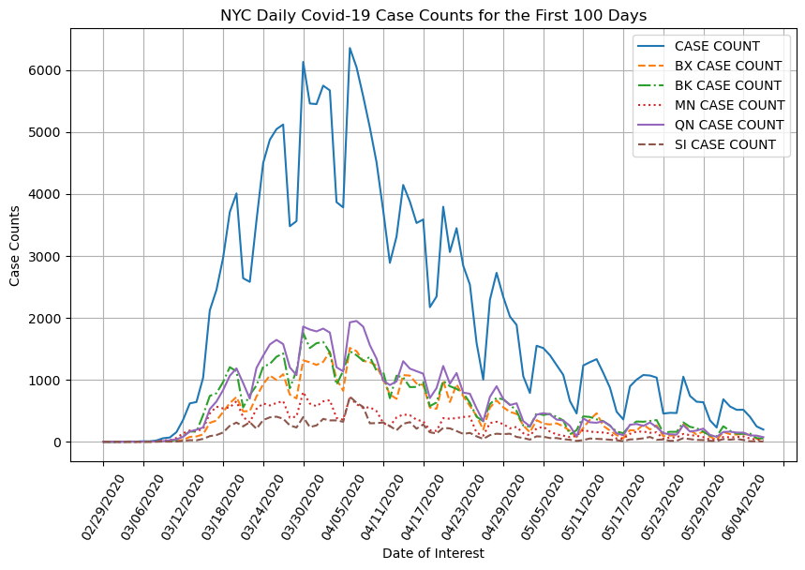
Daily case counts in the first 100 days for each nyc borough

Slide 9
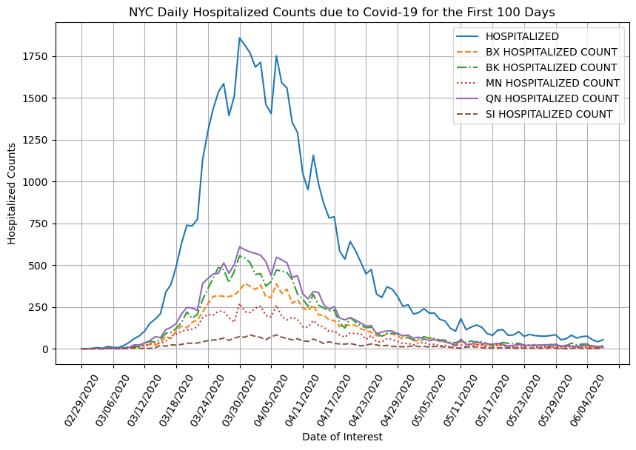
Daily hospitalization counts in the first 100 days for each borough

Slide 10
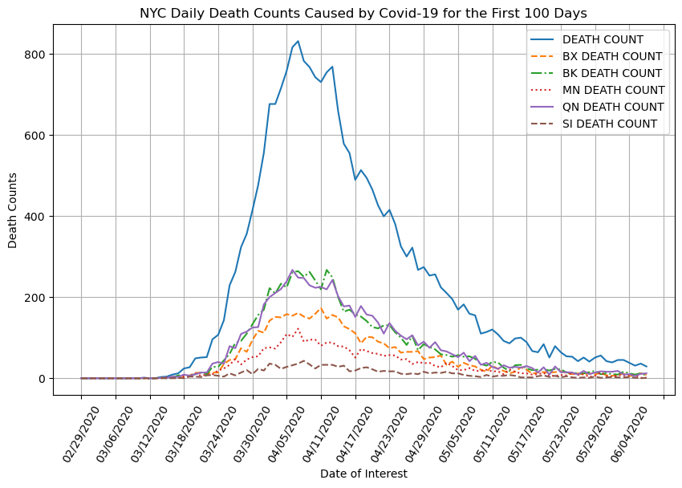
Daily death counts in the first 100 days for each bourough

Slide 11
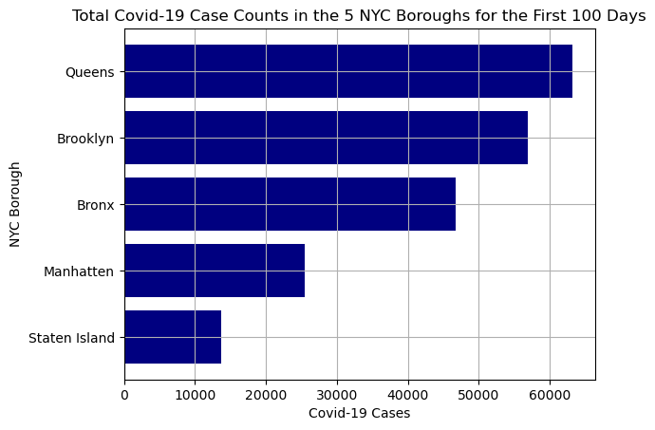
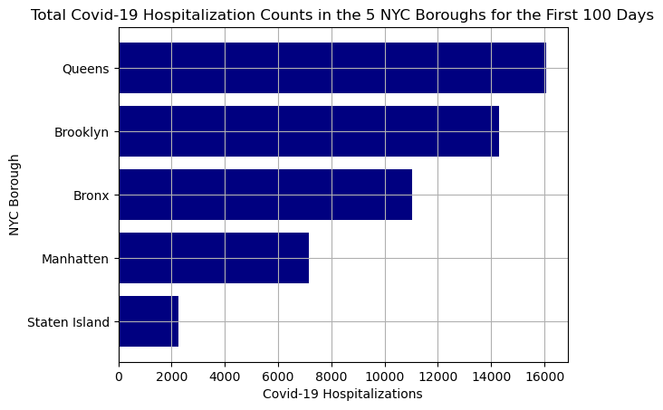
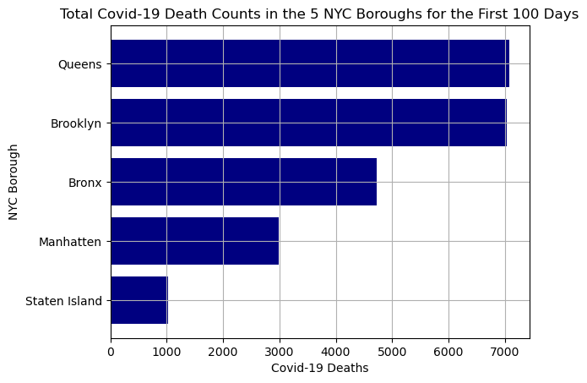
Five Nyc borough totals for the first 100 days
Total NYC Case Counts = 206020 Total NYC Hospitalizations = 50790 Total NYC Deaths Due to Covid = 22852 Total QN Case Counts = 63176 Total QN Hospitalizations = 16060 Total QN Deaths Due to Covid = 7077 Total BK Case Counts = 56837 Total BK Hospitalizations = 14306 Total BK Deaths Due to Covid = 7027 Total BX Case Counts = 46782 Total BX Hospitalizations = 11017 Total BX Deaths Due to Covid = 4729 Total MN Case Counts = 25491 Total MN Hospitalizations = 7153 Total MN Deaths Due to Covid = 2995 Total SI Case Counts = 13727 Total SI Hospitalizations = 2254 Total SI Deaths Due to Covid = 1024

Slide 12

Question 3 How severe was the covid-19 pandemic in nyc?

Slide 13

How severe was the covid-19 pandemic in nyc in the first 100 days?
The severity of the pandemic is reflected through the percent of hospitalizations and deaths to case counts.
The percentages are as follows for each of the boroughs in the first wave. For the entire city, there was about a 25 percent chance that if someone contracted Covid-19, they would require hospital treatment and about an 11 percent chance that death would occur from Covid-19. These are not good odds.
Total Hospitalizations to case counts was 24.7%.
Total Deaths to case counts was 11.1%.
Bronx Hospitalizations to Bronx case counts was 23.5%.
Bronx Deaths to Bronx case counts was 10.1%.
Queens Hospitalizations to Queens case counts was 25.4%.
Queens Deaths to Queens case counts was 11.2%.
Brooklyn Hospitalizations to Brooklyn case counts was 25.2%.
Brooklyn Deaths to Brooklyn case counts was 12.4%.
Manhattan Hospitalizations to Manhattan case counts was 28.1%. Manhattan Deaths to Manhattan case counts was 11.7%.
Staten Island Hospitalizations to Staten Island case counts was 16.4%. Staten Island Deaths to Staten Island case counts was 7.5%.

Slide 14

Question 4 is there a time of the year with the most impact due to covid-19?

Slide 15
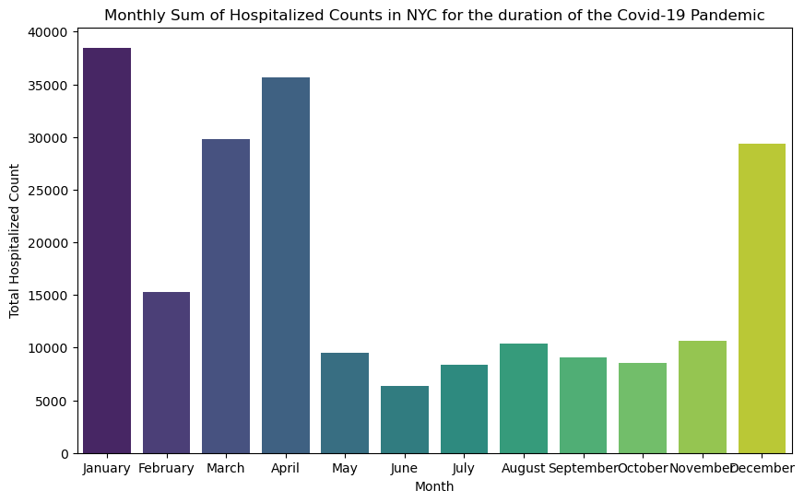
Is there a time of the year with the most impact due to covid-19?
The following bar chart shows the summed total of all hospitalizations in NYC for the entirety of the data set grouped by month.
The results show a maximum of hospital visits caused by the Covid-19 virus occurred in the month of January with the months of December through April being the busiest time.
The months of May through November are a reprieve.

Slide 16
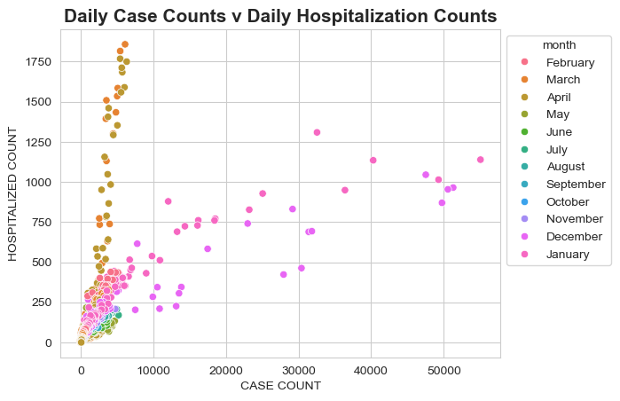
The worst days
Four Quadrant analysis to show as outliers which were the worst of days and what months did these occur in.
Each point is a day, and the y-axis shows daily hospitalization counts and the x-axis shows daily case counts.
The months of March and April produced some of the worst days for hospitalizations needed.
The months of December and January produced some of the worst daily case counts.

Slide 17
conclusion
One thing I learned from this data set is that public policy should be data driven. What really stood out to me from the first graph is the number of daily case counts that occurred during the third wave in the winter of 2021-2022 after the restrictions were relaxed. This is after two years of the pandemic and vaccinations were available to everyone which resulted in much lower percentages of hospitalizations and deaths. What would happen if government officials didn’t have the courage to shut down the economy in the early days of the pandemic for the sake of public health? One could extrapolate that if case counts soared in the first wave like they did in the third wave with the same odds for survival faced in the beginning before herd immunity was in place, fatalities could have been ten times higher, and the health care system would have collapsed.

Slide 18
Thank you
Dana Tryon
Data Science Programming
CMP-262-26222

